Slide 1
Implementation Science Models (and related metrics) to Help Reduce Health Disparities
Russell E. Glasgow, Ph.D.
Deputy Director, Implementation Science
Division of Cancer Control and Population Sciences National Cancer Institute

Slide 2
Outline
IS Overview
RE-AIM
EIT Implications
Commonalities
Implementation Science (IS) Models-overview
RE-AIM Model—and metrics
Evidence Integration Triangle (EIT)
Commonalities and Conclusions

Slide 3
IS Overview
RE-AIM
EIT Implications
Commonalities
Implementation Science Frameworks: Converging Recommendations
Recent review of Implementation Science Models (Tabak RG, et al. Am J Prev Med 2012;43:337-50)
RE-AIM: Reach, Effectiveness, Adoption, Implementation and Maintenance—the “What”
www.re-aim.org
Evidence Integration Triangle (EIT)—the “How” http://cancercontrol.cancer.gov/IS/presentations.html

Slide 4
IS Overview
RE-AIM
EIT Implications
Commonalities
Implementation and Dissemination Research Characteristics (Russ’ view)
Contextual
Complex
Multi-component programs and policies
Non-linear
Transdisciplinary
Multi-level
Addresses “wicked”, messy, important problems
Glasgow RE, Steiner JF In: Brownson RC, Colditz G, Proctor E, eds. Dissemination and implementation research in health: Translating science and practice. New York: Oxford University Press, 2012:72-93.

Slide 5
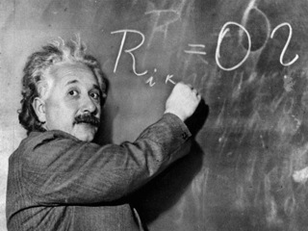
The same policies, research methods, paradigms and approaches that produced today’s inequities are not likely to reduce them
“The significant problems we face cannot be solved by the same level of thinking that created them.”
A. Einstein

Slide 6
IS Overview
RE-AIM
EIT Implications
Commonalities
Recommended Purpose of Research (ala RE-AIM—www.re-aim.org)
Collect evidence to document interventions that can:
Reach large numbers of people, especially those who can most benefit
Be widely adopted by different settings
Be consistently implemented by staff members with moderate levels of training and expertise
Produce replicable and maintained effects (and minimal negative impacts) at reasonable cost
Gaglio B, Glasgow RE. In: Brownson R, Colditz G, Proctor E, eds. Dissemination and implementation research in health: Translating science to practice. New York: Oxford University Press, 2012:327-56

Slide 7
RE-AIM—Disparities Implications
RE-AIM Element
Reach | Characteristics of those who participate vs. decline Expand categories used for classification of potential disparities- e.g. literacy, numeracy, address, geospatial
Effectiveness | “Representative narrative” Impact of context Unanticipated consequences
Adoption | Engage stakeholders from low resource settings from outset Document and address reasons for non-participation
Implementation | Monitor Delivery Track costs of implementation Be transparent
Maintenance | Assess long-term results of different subgroups…If inequities, find out why Prepare delivery settings with tools to guide, monitor and adapt intervention Support and study sustainability

Slide 8
RE-AIM—Disparities Implications Continued
RE-AIM Issue | Disparity | Overall Impact
Reach | 30% | 70% of benefit
Effectiveness | 0 (equal) | 70% of benefit
Adoption | 30% | 49% of benefit
Implementation | 30% | 34% of benefit
Maintenance | 30% | 24% of benefit

Slide 9
IS Overview
RE-AIM
EIT Implications
Commonalities
RE-AIM Implications— What Outcomes and Metrics are Valuable?
Beyond Mean Effect Size?
Ask- at multiple levels WHO is reached, WHAT type settings are implementing; WHICH staff can implement, etc.
All 5 RE-AIM dimensions are important—need to broaden usual focus

Slide 10
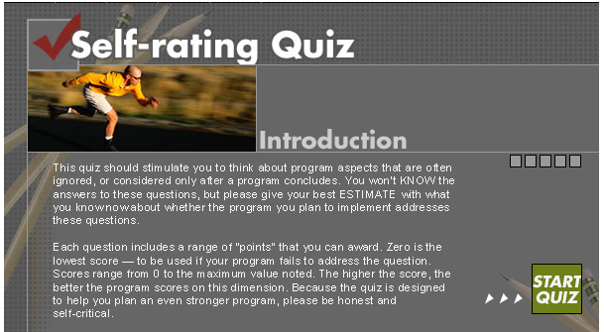
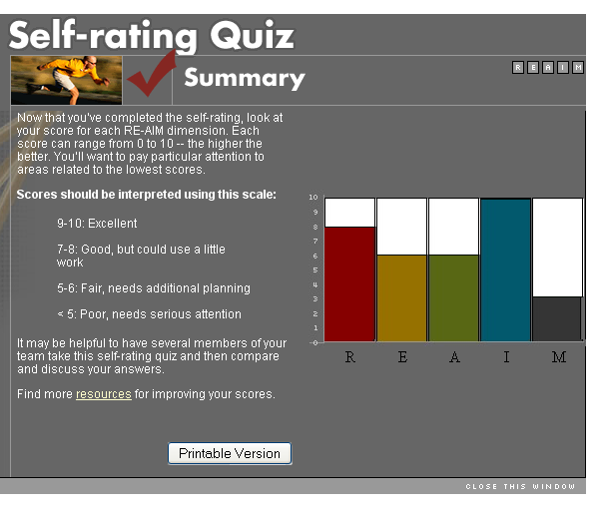
IS Overview
RE-AIM
EIT Implications
Commonalities
RE-AIM Self-Rating Quiz
http://re-aim.org/resources_and_tools/index.html

Slide 11
Evidence Integration Triangle (EIT)
Intervention Program/Policy (Prevention or Treatment)
(e.g., key components; principles; guidebook; internal & external validity)
Feedback
Evidence
Feedback
Stakeholders
Participatory Implementation Process
(e.g., stakeholder engagement; CBPR; team-based science; patient centered)
Feedback
Practical Progress Measures
(e.g., actionable & longitudinal measures)
Multi-Level Context
Intrapersonal/Biological | Policy
Interpersonal/Family | Community/Economic
Organizational | Social/Environment/History
Glasgow RE, Green LW, Taylor MV, et al. Am J Prev Med 2012;42:646-54

Slide 12
Implications of EIT for Reducing Disparities
IS Overview
RE-AIM
EIT Implications
Commonalities
Evidence alone is a start, but not enough
Need relevant, practical Measures and Metrics of progress
Both of above need to be selected with partnership of stakeholders
Expect iteration and adaptation—rather than immediate success

Slide 13
Questions to Ask….
IS Overview
RE-AIM
EIT Implications
Commonalities
In this world of “the 4 P’s” of personalized medicine…. ALSO ask the 4 “W’s”:
Who Benefits
Who Suffers
Who Pays
Who Profits
Glasgow RE, Fisher EB, Haire-Joshu D, Goldstein MG. Am J Public Health 97(11):1936-1938 (Editorial)

Slide 14
Take-Home Points
IS Overview
RE-AIM
EIT Implications
Commonalities
Start with the End (Dissemination? Scale-Up: Sustainability? Reducing Disparities?) in Mind
Start with and Partner with Stakeholders Throughout All Phases…… including Design and Analyses
Implementation Science is Complex, Dynamic, Contextual, Learning, Systems Based…. and our models, designs and metrics need to be also
All Models (including these) are WRONG….but may be useful

